Slide 1
PROJECT
Submitted by
J.VINCY

Slide 2
Problem statement
Write a C program to create a list of software application details. The details of application include name, author, version, publishing year , price
Perform the following with respect to the list of application created.
a) Display all the details of application by a given author.
b) Sort the details of application in the increasing order of price.
c) Display the details of applications published by a given publisher in a given year.
d) Sort the list of applications in the increasing order of two fields , author and publishing year of the books

Slide 3
Abstract
We create the book application in the following steps.
First, we've stored the book details in an array in the issue. The author's name, publication, price, year, and other information are included in the book details. We proceeded to present application details based on the menu choices.
In the first situation, we had to ask the user for the author's name. The book details will be displayed based on the author name.
In the second scenario, we can print the book datails in ascending price order.

Slide 4
In the third scenario, we ask the user for the publisher's name and year. We can display book details based on the user's information.
In the fourth scenario, we may use the two fields for author name and publishing year to print the book details in ascending order.

Slide 5
Flow chart
start
Print the stored value
Print the menu
Select the menu

Slide 6
expression
Equal case1
yes
Book of specific author
no
Equal case 2
yes
Increasing order of book price

Slide 7
Equal case3
yes
Book of publisher by year
no
Equal case4
yes
Sorts of book in author and year
stop

Slide 8
Algorithm
Case 1 :
Step 1: get the author name from user
Step 2: for condition
Step 3: if condition if it is true ,then go to step 4 . otherwise to step 6
Step 4: print the book details
Step 5: increment the value of I by 1
Step 6: go to step 2
Step 7: stop.

Slide 9
Case 2:
Step 1: copy the unsorted price value
Step 2: for condition.
Step 3: for condition.
Step 4: if condition . if it is true, go to step 5. otherwise step 8.
Step 5: assign price[ I ] to temp.
Step 6: assign price[ j ] to price[ I ].
Step 7: assign temp to price[ j ].
Step 8: increment the value of j by 1.
Step 9: go to step 4.
Step 10: increment the value of I by 1.
Step 11: using for condition print the sorted value.
Step 12: stop.

Slide 10
Case 3:
Step 1: get the author name and year from user.
Step 2: for condition
Step 3: if condition if it is true ,then go to step 4 . otherwise to step 6
Step 4: print the book details
Step 5: increment the value of I by 1
Step 6: go to step 2
Step 7: stop.

Slide 11
Case 4:
Step 1: copy the unsorted author and year value
Step 2: for condition.
Step 3: for condition.
Step 4: if condition . if it is true, go to step 5. otherwise step 8.
Step 5: assign price[ I ] to temp.
Step 6: assign price[ j ] to price[ I ].
Step 7: assign temp to price[ j ].
Step 8: increment the value of j by 1.
Step 9: go to step 4.
Step 10: increment the value of I by 1.
Step 11: using for condition print the sorted value.
Step 12: stop.

Slide 12
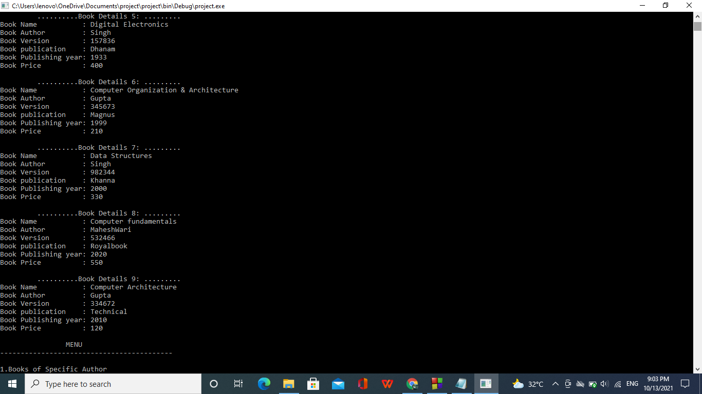
output

Slide 13
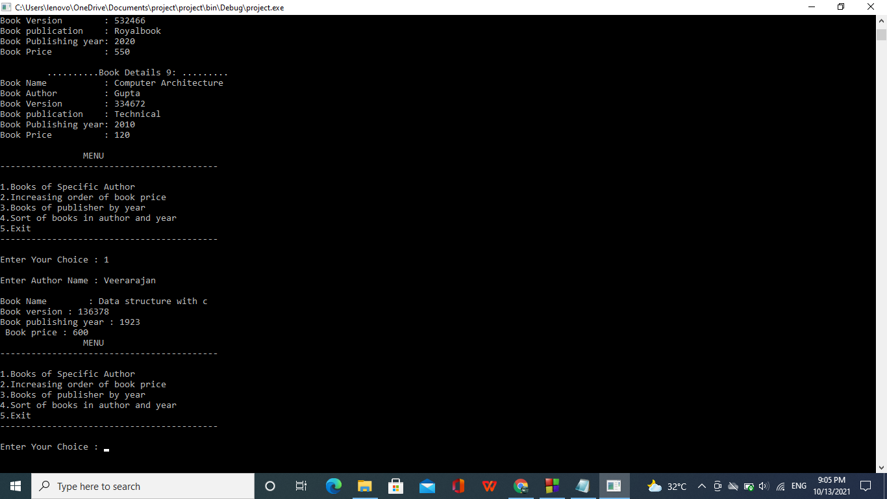

Slide 14
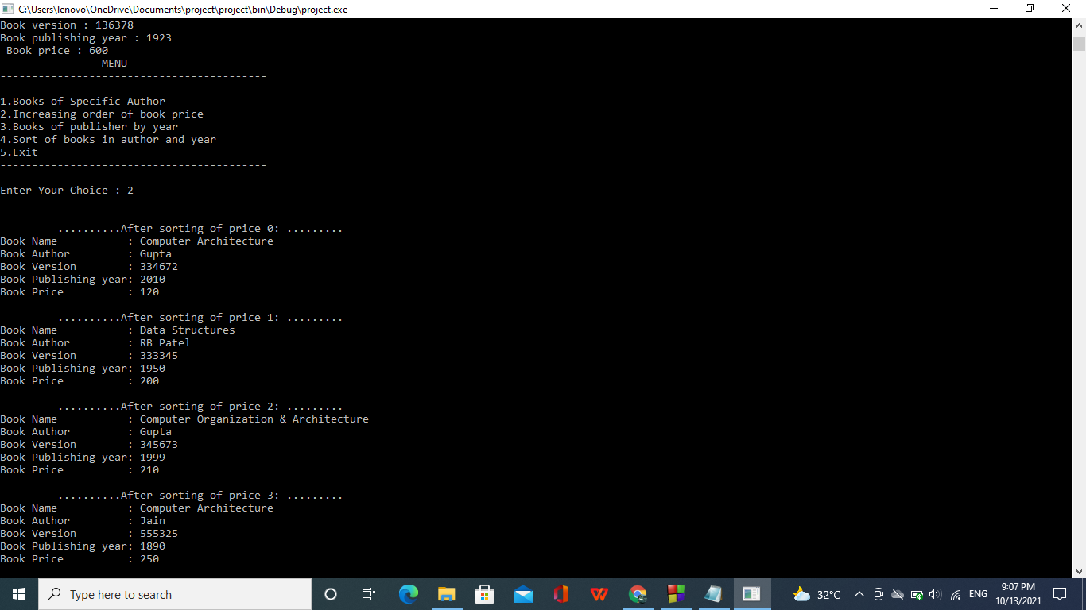

Slide 15
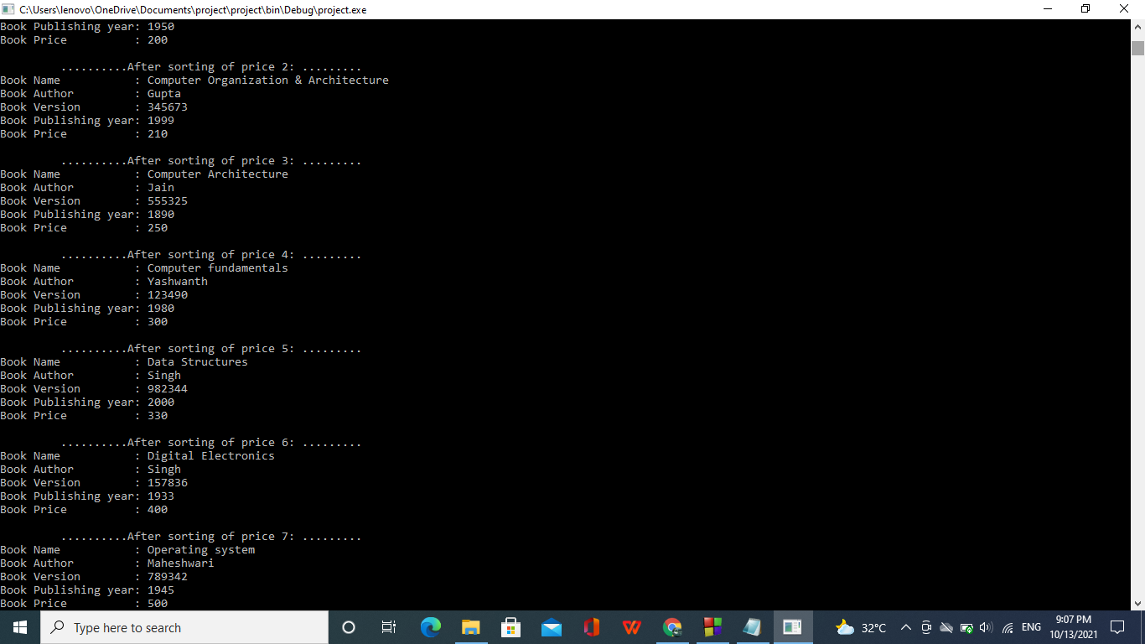

Slide 16
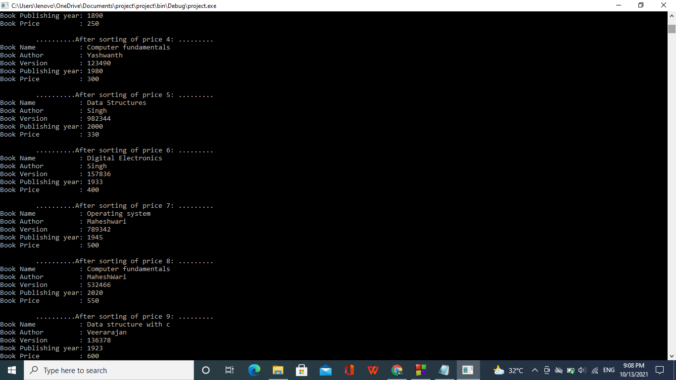

Slide 17
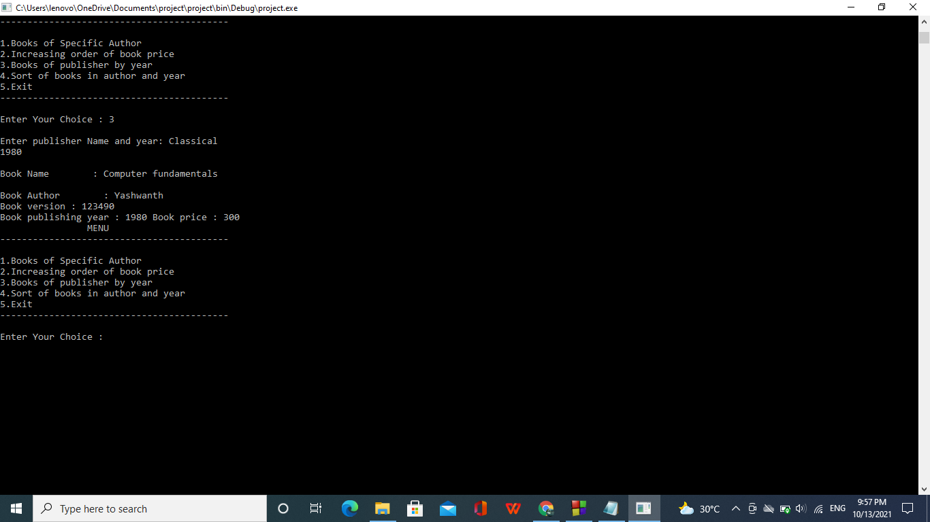

Slide 18
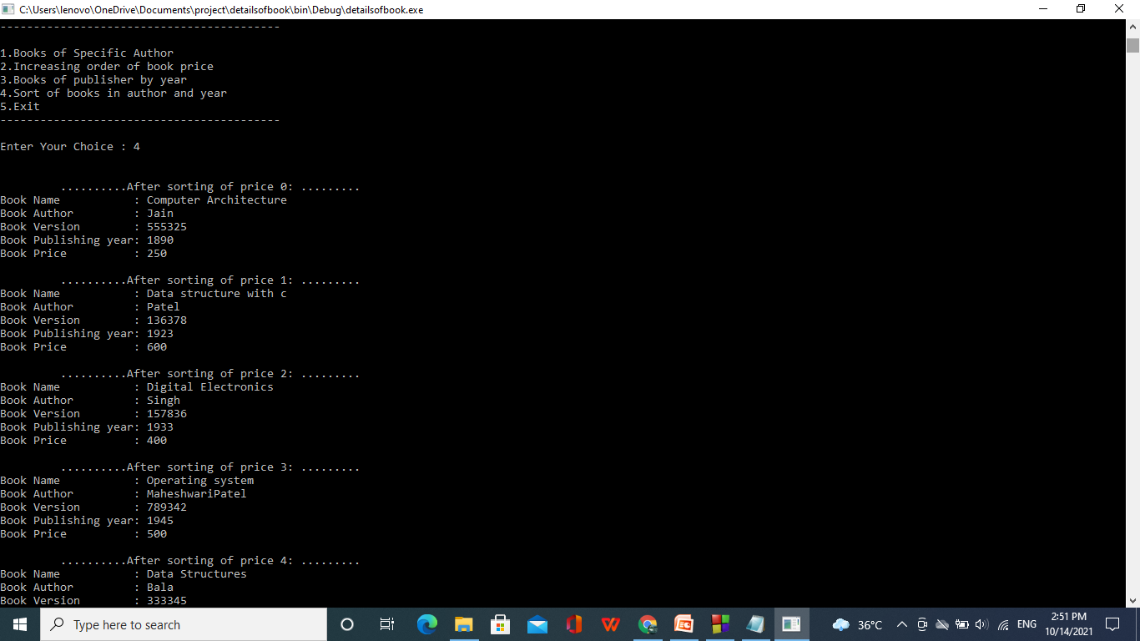

Slide 19
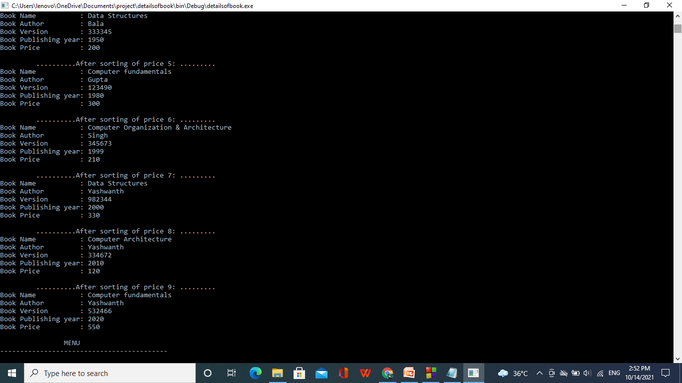

Slide 20
Thank you!

